Slide 1
Kubernetes
Notes:
1

Slide 2
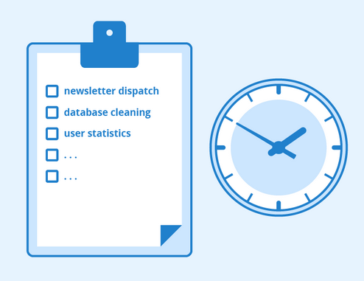
Jobs and CronJobs
Notes:
2

Slide 3

Jobs - Use case
Large computation to perform
Repeating a task every day at scheduled time
For Exp:- Take database backup every day
Run garbage collection every hour
Notes:
3

Slide 4
Jobs
Is a workload controller that supervises PODs to perform finite task
Useful for large computation and batch-oriented tasks
Notes:
4

Slide 5
Types of Jobs
Run to Completion
ie Controller will wait for exit code 0
Scheduled
Similar to cronjobs in linux
Notes:
5

Slide 6
Types of Jobs
Run to Completion
ie Controller will wait for exit code 0
Scheduled
Similar to cronjobs in linux
Notes:
6

Slide 7
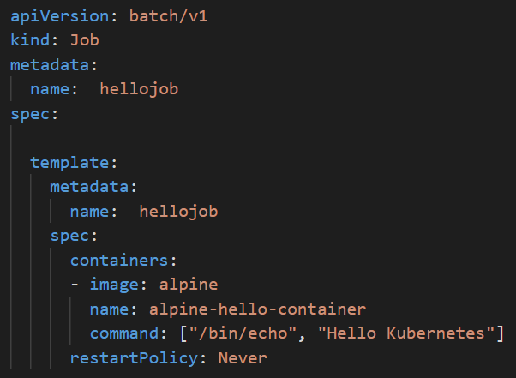
Jobs - Run to completion
Each Job creates one or more PODs
Ensure that POD is completed successfully
Can run multiple PODs in parallel
If a Job fail during execution, the Job Controller will restart
or reschedule it
Scale up/Down using kubectl scale command
Notes:
7

Slide 8
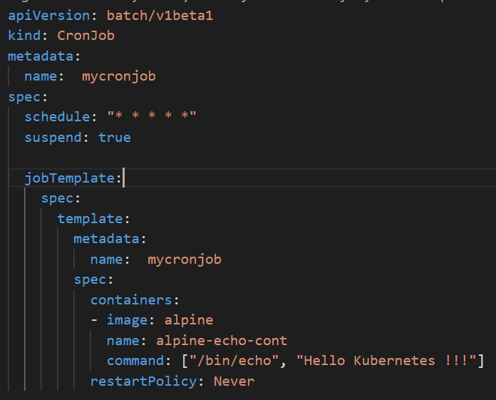
Cron Jobs
Run jobs based on a schedule
Automated backups, synchronization with remote services
and application maintenance
Notes:
8

Slide 9
Namespaces
Partition a single Kubernetes cluster into multiple virtual clusters
Logical entity to represent cluster resources for usage of a particular set of users.
Helps to address the complexity of organizing objects within a cluster
Notes:
9

Slide 10
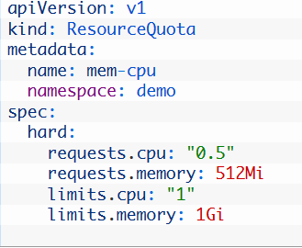
Namespaces
Can maintain copies of the same objects, with the same names, in app life cycle environment
For Exp: - DEV, STAGING, PROD
Easily apply policies to specific slices of your cluster
For Exp:- ResourceQuota, Network Policy etc
Notes:
10

Slide 11
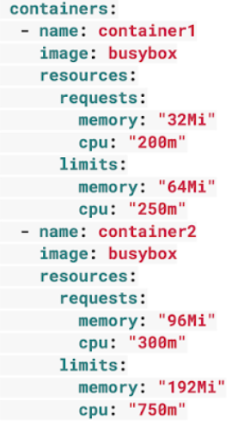
Resource Limits
Requests are what the container is guaranteed to get
Limits make sure a container never goes above a certain value
Notes:
11

Slide 12
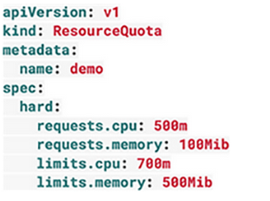
Resource Quotas
requests.cpu is the maximum combined CPU requests in millicores for all the containers in the Namespace.
limits.cpu is the maximum combined Memory limits for all containers in the Namespace
requests.memory is the maximum combined Memory requests for all the containers in the Namespace
limits.memory is the maximum combined Memory limits for all the containers in the Namespace
Notes:
12

Slide 13
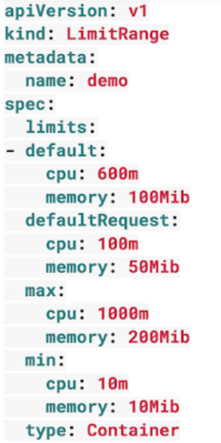
Limit Range
LimitRange applies to an individual container
Can help prevent people from creating super tiny or super large containers inside the Namespace.
Notes:
13

Slide 14
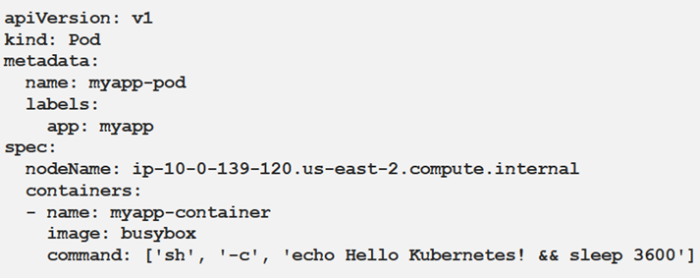
Manual POD scheduling
nodeName
Notes:
14

Slide 15
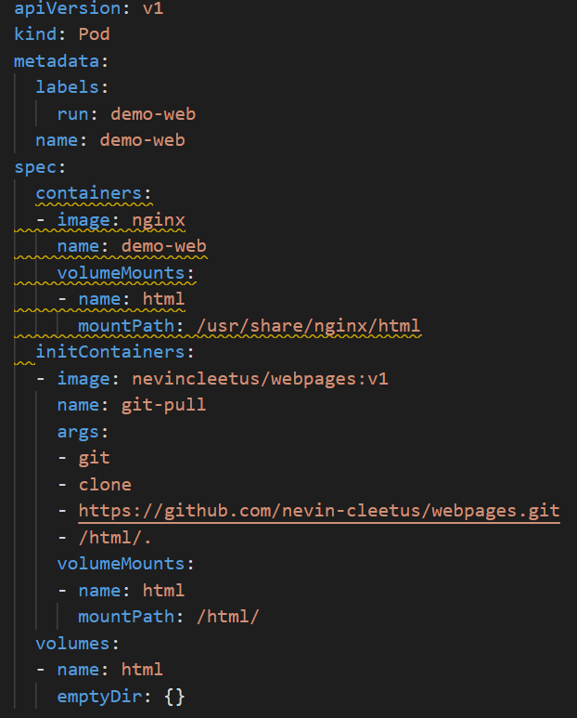
init Containers
Run only once during the startup of the Pod
Notes:
15

Slide 16
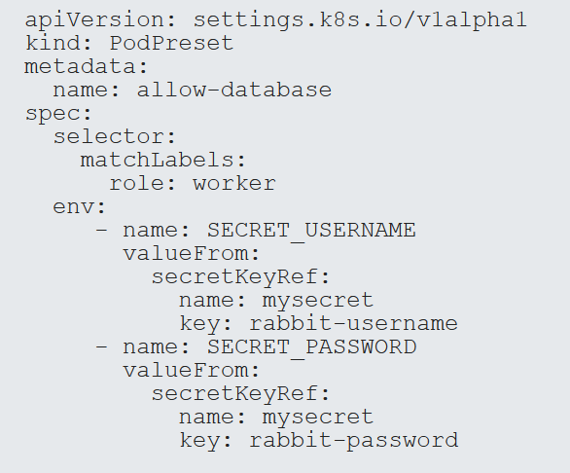
POD Preset
Used for injecting common information to all Pods at creation time
Notes:
16

Slide 17
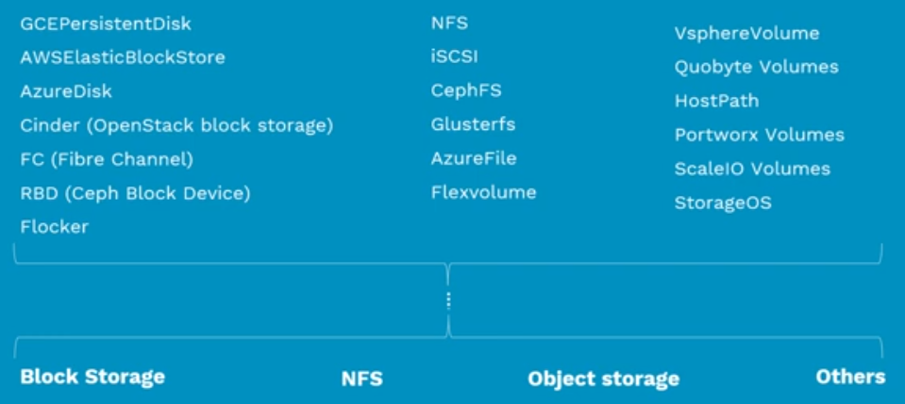
Persistent Volume

Slide 18
Persistent Volumes
Standard API
Block Storage
NFS
Object Storage
Cloud Storage

Slide 19
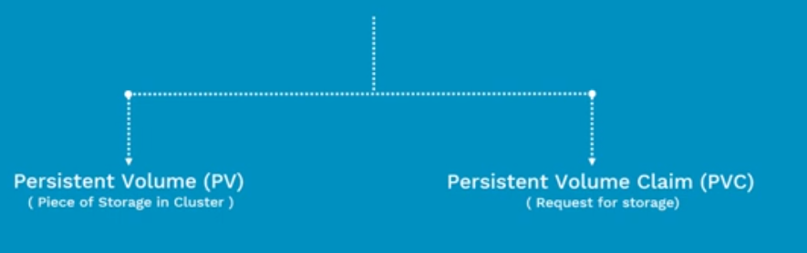
Persistent Volumes
Abstract details of how storage is provided from how it is consumed

Slide 20
What is Persistent Volume (PV)?
Pre Provisioned storage in a Kubernetes cluster
Represent the backend storage entity that a pod might consume.
Data can exists beyond the lifecycle of a POD

Slide 21
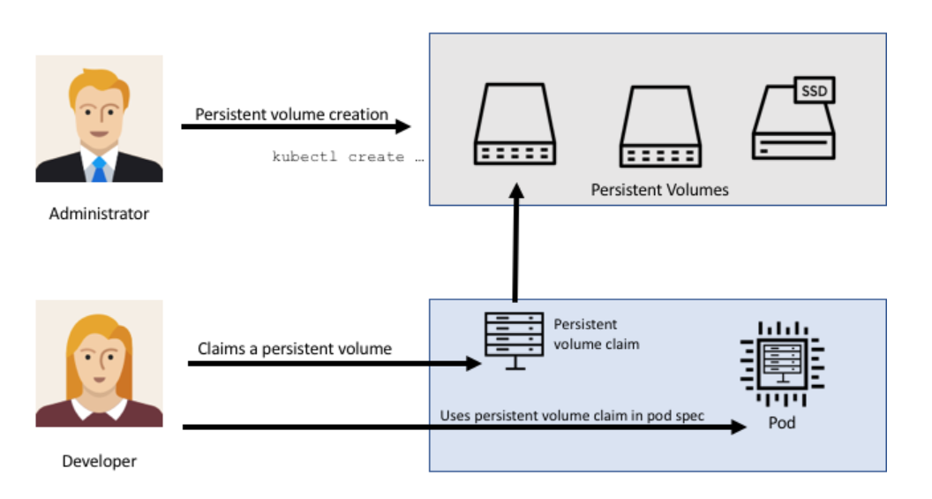
Persistent Volume

Slide 22
Persistent Volume
apiVersion: v1
kind: PersistentVolume
metadata:
name: pv0003
spec:
capacity: storage: 5Gi
accessModes: - ReadWriteOnce
persistentVolumeReclaimPolicy: Recycle
nfs:
path: /tmp
server: 172.17.0.2
Capacity - storage capacity
Access Modes - ReadWriteOnce
ReadOnlyMany
ReadWriteMany
Recycling Policy Retain (manual reclaim)
Recycle

Slide 23
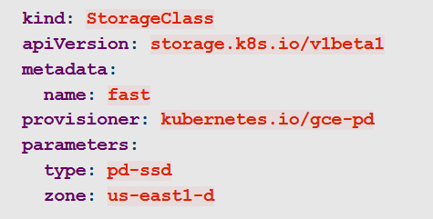
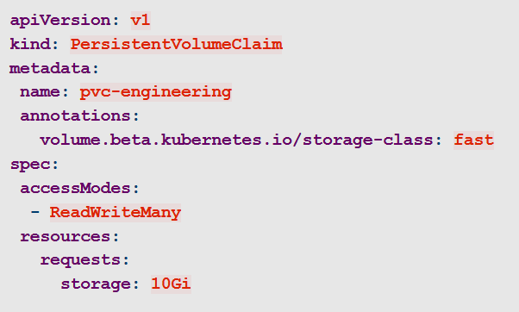
Dynamic Provisioning of volumes
Users can request dynamically provisioned storage by including a storage class annotation in their persistent volume claim:

Slide 24
POD Health Checks
Liveness Probe - Kubernetes uses liveness probes to know when to restart a container
Readiness Probe - to decide when the container is available for accepting traffic
Notes:
24

Slide 25
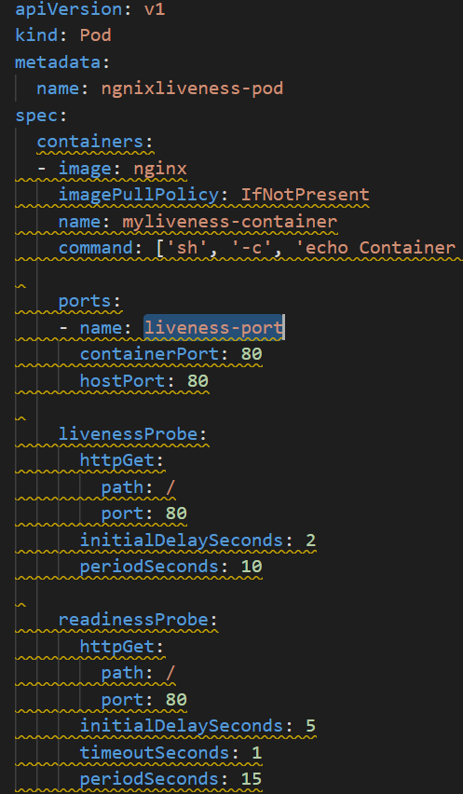
POD Health Checks
initialDelaySeconds - How long to wait before sending a probe after a container starts.
timeoutSeconds How long a request can take to respond before it’s considered a failure.
periodSeconds How often a probe will be sent.
Notes:
25

